Slide 1


An investigation into voice-controlled web browsing for the elderly
ELEN4012 : Information Engineering Laboratory
Authors: Cole Noble, Kirti Nathoo
October 2011

Slide 2
Outline
Voice-controlled web browsing for the elderly
Background
Objectives
Software Application
Testing and Results
Analysis
Team Work
Conclusion
Future Work

Slide 3
Background
Background
Statistics show growing use of computers by the elderly.
US stats:
People over 65 are the fastest growing group of new internet users.
13% of population is comprised of the elderly.
4% of total internet usage is contributed to by the elderly.
Anderson S, Liberman N, Bernstein E, Foster S, Cate E, Levin B. Recognition of elderly speech and voice-driven document retrieval. Dragon Systems, Inc, 1999 IEEE, pp 1.
Conn N, McTear M. Speech Technology: A Solution for People with Disabilities. Faculty of Informatics, University of Ulster at Jordanstown, United Kingdom, 2000 IEEE, pp 1.
Notes:
Reasons [1]
No previous interaction with computers
Reluctance to use new technology
Physical difficulty in using the keyboard

Slide 4
Background
The internet offers online shopping entertainment, banking and communication.
Why is 9% of the US population not using the internet?
Computer literacy.
Health conditions.
Anderson S, Liberman N, Bernstein E, Foster S, Cate E, Levin B. Recognition of elderly speech and voice-driven document retrieval. Dragon Systems, Inc, 1999 IEEE, pp 1.
Conn N, McTear M. Speech Technology: A Solution for People with Disabilities. Faculty of Informatics, University of Ulster at Jordanstown, United Kingdom, 2000 IEEE, pp 1.
Notes:
The internet offers online shopping, entertainment, banking and provides a means of instant communication. There is a massive group of people that require access to the functions.

Slide 5
Speech Recognition
Background
Form of assistive technology for people with disabilities.
Speech controlled web browsing improves the usability of computers for the elderly.
Anderson S, Liberman N, Bernstein E, Foster S, Cate E, Levin B. Recognition of elderly speech and voice-driven document retrieval. Dragon Systems, Inc, 1999 IEEE, pp 1.
Conn N, McTear M. Speech Technology: A Solution for People with Disabilities. Faculty of Informatics, University of Ulster at Jordanstown, United Kingdom, 2000 IEEE, pp 1.
Notes:
Speech technology is a form of assistive technology that offers potential benefits for people with a wide range of disabilities. In particular, for people with physical disabilities.[Speech Tech - PDF]. Speech technology is said to enhance the quality of life for the elderly.
Speech recognition technology can greatly enhance the quality of life. [Speech Tech - PDF]
Speech controlled internet browsing does not require a great deal of typing and is the optimal starting point to improve the usability of computers for the elderly.[Speech browsing elderly - PDF]

Slide 6
Objectives
Objectives
Determine which speech recognition
techniques improve the usability of web
browsing for the elderly.
Determine whether Numerical or Link name
referencing techniques:
Perform better and,
Are preferred by elderly users.
Notes:
Determine the following objectives in context of elderly users.
The 2 referencing techniques are: numerical referencing and link name referencing. In numerical referencing each link on a page is assigned a numeric identifier. In link name referencing each link on a page can be accessed by saying the link name.

Slide 7
Objectives
Determine which visual and verbal feedback
techniques assist elderly users during web
browsing.
Create a suitable platform for further
investigation into improving computer
usability for the elderly.
Notes:
Determine what feedback techniques or combinations of feedback techniques, are preferred by the elderly. Visual feedback techniques include pop-ups, link highlighting. Verbal feedback refers to voice commands repeated back to the user. Both techniques assist in notifying users of which element is selected on a page.

Slide 8
Software Application
Software Application
Components.
Design.
Implementation.
Notes:
Objectives required a focus on testing, testing was thus carried out by creating specific websites that enabled voice recognition and forms of feedback (to enhance prototype creation speed). The websites were decomposed into components and iterations for each website was designed and implemented.

Slide 9
Components
Software Application
Voice processing
Visual rendering
Navigation
Notes:
Project divided into components.
Visual processing (presentation of website and associated feedback techniques). Visual processing refers to graphical web development. The application provides users with an interactive web page GUI. Done by Kirti Nathoo.
Voice processing (voice referencing techniques and associated logic). The voice recognition component enables users to interact with the application GUI through the use of voice commands. Done by Cole Noble
The navigation component refers to website navigation and integrates both the visual rendering and voice recognition components.

Slide 10
Design
Software Application
Iteration 1:
Referencing technique performance
Visual feedback technique
preference
Verbal feedback
technique
preference
Notes:
The Rapid Application Development (RAD) method is followed. RAD is an agile method wherein requirements are prioritised into iterations to ensure
essential requirements are met first. Discuss the requirements for each iteration.
Determine the performance between numerical and link name referencing techniques for simple websites. Number of errors for referencing techniques and
preference for feedback were recorded
Determine which visual feedback techniques – pop ups or link highlighting – are preferred by users.
Ascertain if users would like verbal feedback whilst using the application.
Perceived performance and preference of the techniques were also noted.

Slide 11
Software Application - Design
Iteration 2:
Warm up tutorial for each technique
Referencing technique performance
Notes:
Investigate the performance of numerical and link name referencing techniques for simple web pages.
Include a tutorial before each section and determine if this is beneficial to users and differs from results previously obtained in iteration one.
Remove feedback techniques which have been previously tested and adequate results were obtained.
Ascertain if users prefer saying a particular word, part of or the complete sentence for the link name referencing technique.

Slide 12
Software Application - Design
Iteration 3:
Referencing technique performance
Combination of feedback techniques
Button to activate voice recognition
User confirmation
More complicated website
Notes:
Determine the performance of numerical and link name referencing styles on complex websites. Determine which technique users prefer.
Determine user response to a combination of feedback techniques.
Ascertain if users think it’s reasonable to expect elderly users to press a button to activate voice recognition each time they speak.
Determine the necessity of user confirmation. (additional interface requirements)
Determine if users would prefer a non-internet based application.

Slide 13
Implementation
Software Application
Voice recognition.
Visual rendering.

Slide 14
Voice recognition
Software Application - Implementation
Online API from SpeechAPI.com used
Embedded flash component used for streaming
JavaScript used to process string results
More advanced functionality available

Slide 15
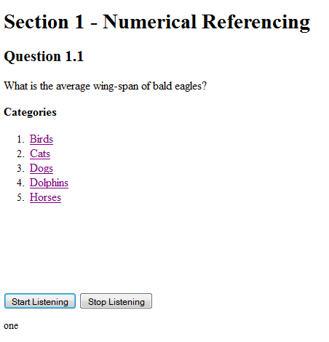
Visual rendering
Software Application - Implementation
Iteration 1 – Numerical Referencing
Notes:
A simple website composed of questions and answers has been developed and used to investigate the performance of numerical and link name referencing
techniques on simple websites.
To initialise speech recognition, the space bar button on the keyboard must first be pressed and released. After answering a question the button must be
pressed again to notify the API that the user has completed speaking.
Each question is based on an animal fact. To answer a question, the correct animal category must first be selected. Upon selecting the category, four facts
are listed and only one fact is the correct answer.
Questions in the numerical referencing section are answered by saying the corresponding number of the animal category and fact number.

Slide 16
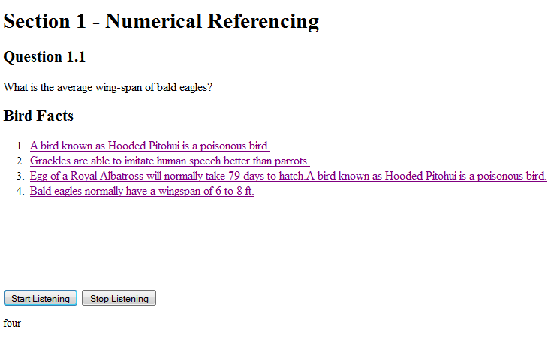
Software Application - Implementation
Iteration 1 – Numerical Referencing

Slide 17
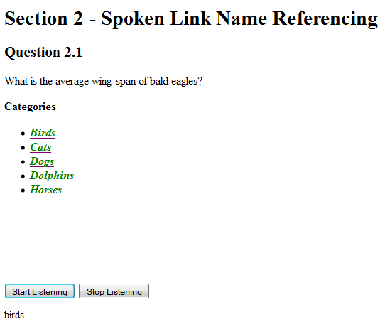
Software Application - Implementation
Iteration 1 – Link Name Referencing
Notes:
To answer questions in the link name referencing section, the green highlighted text must be said.

Slide 18
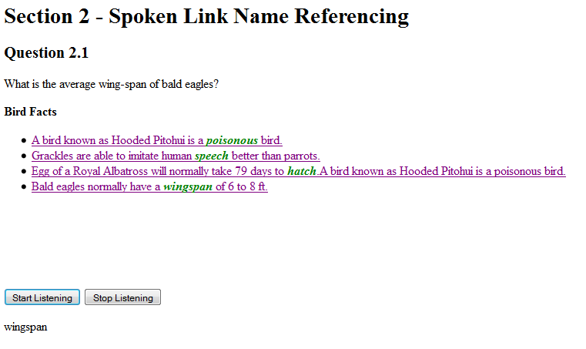
Software Application - Implementation
Iteration 1 – Link Name Referencing

Slide 19
Software Application - Implementation
Iteration 2 -
No feedback sections
Notes:
A large number of errors were recorded for the first referencing technique in iteration one. To remain unbiased to a particular referencing style, the website
in iteration one was restructured and tested again to determine the performance of referencing techniques on simple websites. In this instance all the
feedback sections have been removed.

Slide 20
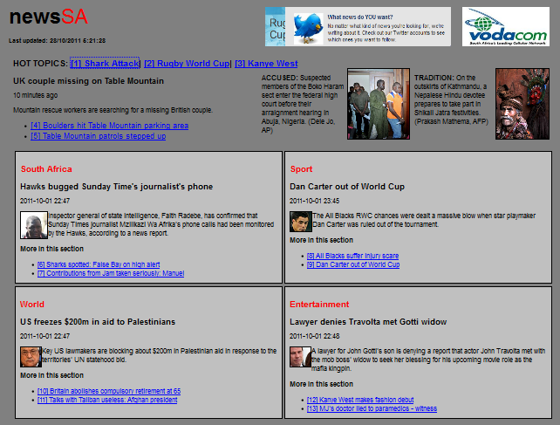
Software Application - Implementation
Iteration 3 – Numerical Referencing
Notes:
A facsimile of a local news website has been designed for iteration three. Numerical and link name referencing techniques have been applied to the website to determine the performance of these techniques on complex and realistic websites. Two versions of the website facsimile have been created. The numerical referencing technique is applied to the first version wherein links are accessed by saying the associated number. To activate speech recognition for either of the websites, the ctrl button on the keyboard must be pressed before speaking.

Slide 21
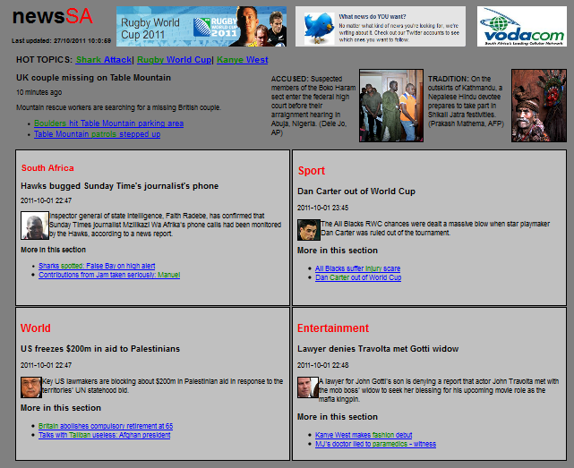
Software Application - Implementation
Iteration 3 – Link Name Referencing
Notes:
Link name referencing is applied to the second version of the website wherein links are accessed by saying the text highlighted in green

Slide 22
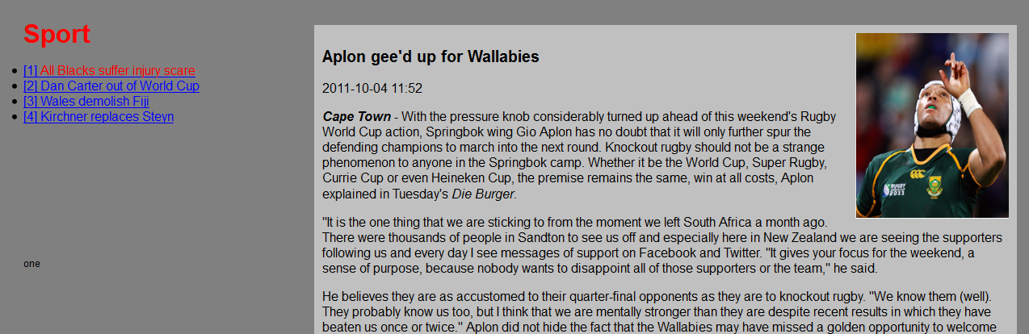
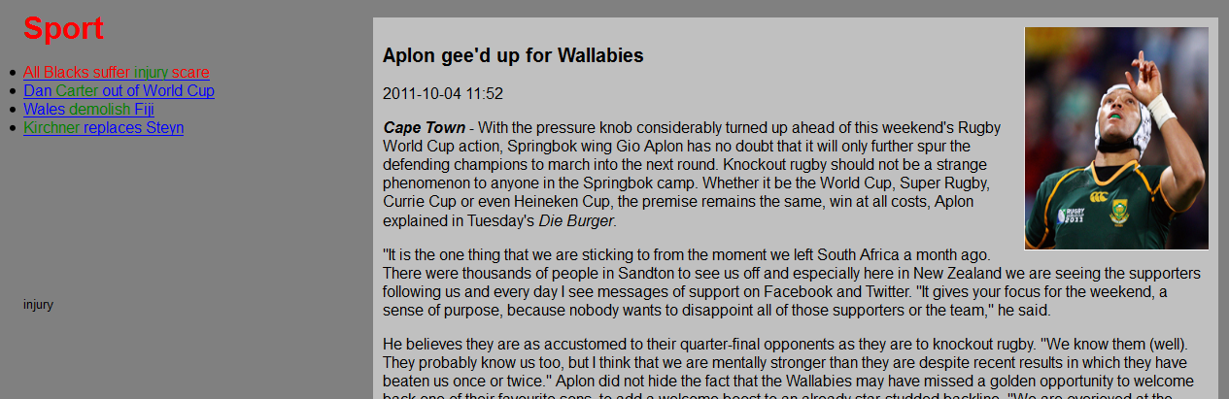
Software Application - Implementation
Iteration 3 – Feedback
Notes:
Navigation commands such as up, down, home and backwards have been included. Verbal feedback has been incorporated where commands spoken by the user are verbally repeated back to the user. User confirmation has been integrated into the application for complex navigation methods such as selecting a link or going backwards. After an action is selected by the user, yes or no verbal confirmation must be provided. In the event of recognition errors, users are requested to repeat the command. Link highlighting has been provided as visual feedback. Upon selecting a link, the colour of the selected link changes to red to notify the user that the element is selected. Visual feedback and user confirmation ensure that correct elements are selected which improves the performance and accuracy of the voice navigation.

Slide 23
Testing and Results
Testing and Results
Iteration 1.
Iteration 2.
Iteration 3.
Secondary results.

Slide 24
Iteration 1
Testing and Results
Application errors:
Numerical referencing: 70.3%.
Link name referencing: 29.16%.
User preference:
Notes:
Application errors were cases wherein voice commands were misread, not recognised or not accepted. The remaining percentage was due to user errors,
i.e. mistakes made by users whilst using the application.
In the numerical referencing section 70.3% application errors were recorded in comparison to the link name referencing section wherein 29.16% errors
were recorded. The high error percentage in the numerical referencing section may be due to the similarities between numbers spoken. Numbers are short
single syllable words that may decrease the accuracy of speech recognition.
57.14% of users prefer using numerical referencing for simple websites. 28.57% prefer link name referencing and the remaining 14.29% are fond of both
techniques

Slide 25
Testing and Results - Iteration 1
Perceived better performance:
Feedback:
Notes:
28.57% of users felt that numerical referencing performed better in comparison to 57.14% of users that felt that link name referencing performed better.
Upon analysis of the results and the large number of application errors recorded for the numerical referencing section, it was considered that perhaps the
numerical referencing section experienced a large number of errors because it was the first referencing style that was being tested. Users might have still
been becoming accustomed to using the application and different referencing styles. This possibility informed the design of the second iteration.

Slide 26
Iteration 2
Testing and Results
Application errors:
Numerical referencing: 68.18%.
Link name referencing: 31.18%.
User preference:
Notes:
This was not significantly less than the total of 48 application errors recorded in iteration one. This indicated that numerical testing was fairly tested in the
first iteration.
Of the application errors recorded, 68.18% were recorded for numerical referencing and the remaining 31.8% was recorded for link name referencing.
Upon observing the results collected it was calculated that 60% of users preferred using numerical referencing in comparison to 20% of users who
preferred link name referencing. The remaining 20% are fond of both techniques.

Slide 27
Testing and Results – Iteration 2
Perceived performance:
Link name referencing:
Notes:
Although 60% of users prefer numerical, 60% of users actually felt that link name referencing performed better than
numerical referencing. None of the users felt that numerical referencing performed well and the remaining 40% felt that both techniques performed
equally.
For link name referencing, 80% of users prefer saying a specific word in comparison to the remaining 20% whom prefer saying the complete sentence. None of the users preferred saying part of a link

Slide 28
Iteration 3
Testing and Results
Application errors:
Link name referencing: 54.76%.
Numerical referencing: 45.23%.
Equal user preference.
Button for speech recognition.
User confirmation.
Notes:
For the application errors recorded, 45.23% were recorded for numerical referencing and the remaining 54.76% of errors was recorded for link name
referencing.
Between the website versions, 50% of users prefer using numerical referencing and the other 50% of users prefer link name referencing.
Users were asked if it was unreasonable to expect elderly users to press a button to activate speech recognition. 50% of users felt that is was unreasonable
and the other 50% thought it was an acceptable requirement. This requirement is still debatable.
Users were questioned to ascertain if user confirmation was necessary and 62.5% of users felt that it was not necessary. The remaining 37.5% felt that
confirmation was necessary to ensure optimal performance of the application.

Slide 29
Secondary Results
Testing and Results
Application errors between males and
females.
Notes:
The number of application errors between males and females were calculated. For each iteration the number of male and female users tested was recorded. Thereafter for each iteration, the total application errors for each gender was totalled and divided by the number of males and females respectively. From the figure it is evident that females experienced substantially more errors than males in all three iterations. This large error rate may also be due to the fact that many of the females users tested were not computer literate and have never used a computer before. Additionally females speak softer and were much more nervous in comparison to the males whilst using the application.

Slide 30
Testing and Results – Secondary Results
Application errors per user age group.
Notes:
Tested users were further categorised into age groups. Three age groups were defined: 55-65, 65-75 and 75-85 year olds. Application errors were tallied for each age group and divided by the number of users within that group and within each iteration. From the figure, it was observed that for the first two iterations a higher number of application errors were recorded for the oldest age group of users tested as expected. However, unexpectedly in the third iteration the middle age group of users performed significantly worse than the eldest age group. This maybe because more users in the second age group were tested and consequently more errors were recorded in comparison to the number of users tested in the third age group.

Slide 31
Analysis
Analysis
Numerical referencing:
Performs better in complex websites.
Used to improve voice recognition errors.
Notes:
Numerical referencing performs better on complex websites in comparison to simple websites such as those in Iterations 1 and 2.
From the figure it is evident that the highest total of application errors was recorded in iteration three. This may be attributed to the fact that iteration three
consisted of a more complex website. Errors recorded between iteration one and two slightly decreased after restructuring the first iteration. However
between the referencing styles, it was evident that for simple websites numerical referencing resulted in far more errors than link name referencing. This
may be due to numbers being short single syllable words. For complex websites link name referencing indicated substantially more errors thank numerical
referencing. These errors are the result of complex words, mispronunciations, etc.
The application errors also indicate that numerical referencing can be user to improve voice recognition errors for the elderly.

Slide 32
Analysis
Users prefer Numerical referencing for simple
websites.
Combinations of Numerical and Link name referencing techniques.
Notes:
As observed in the figure it is evident that for simple websites designed in iterations one and two, users preferred numerical referencing. Even though link
name referencing performs better. This may be due
to the sequential nature and concise vocabulary of numbers. However for complex websites there was no distinct preference between referencing
techniques. For complex websites, both techniques appear to be satisfactory.
Indicates that compound combinations of numerical referencing and spoken link name referencing could be used (for instance, numerical referencing within sections and link name referencing for sections etc.)

Slide 33
Team Work
Conclusion
Fair work division.
Git and Github version control.
Email.
Instant messaging.
Notes:
The project components were fairly divided between team members which enabled easy integration later in the project. Voice processing – Cole, Visual processing – Kirti.
Git was used to collaborate code contributions to the web application.
Github was used to centralise version control. This also increased acted as an additional backup and way of rolling back to prior versions of the project if need be

Slide 34
Conclusion
Conclusion
For simple web pages:
Users prefer numerical referencing.
Link name referencing performs better.
For complex web pages:
No distinct preference.
Numerical referencing performs best.
Link highlighting and verbal feedback are adequate feedback techniques.
Age and gender have significant affects.
Notes:
Age and gender have significant affects on voice recognition performance.

Slide 35
Future Work
Future Work
Algorithm for Link name referencing.
“Smart” command analyzer.
Complex techniques for annotating web pages.
Stand-alone speech engine.
Cross-platform web browser add-on.
Notes:
Algorithm to automatically select key words to be spoken for link name referencing.
“Smart” command analyzer will be able to accept alternative commands. For e.g., back and backwards.
Techniques include: annotating different sections in different colours and enlarging different components to improve visibility.
Stand-alone speech engine will be specifically trained for elderly male and female voices.
Create a generic web-browser add-on with customizable options for elderly (highlighting and section colours, voice referencing styles).

Slide 36
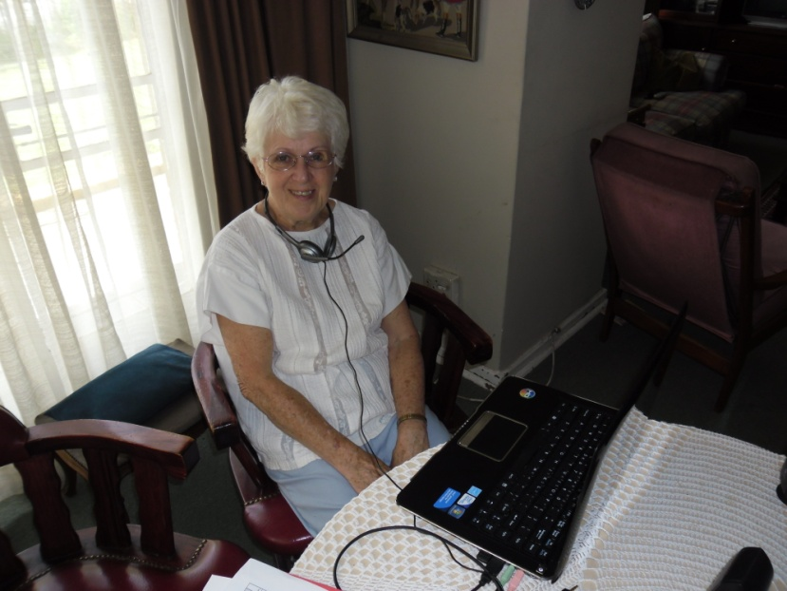
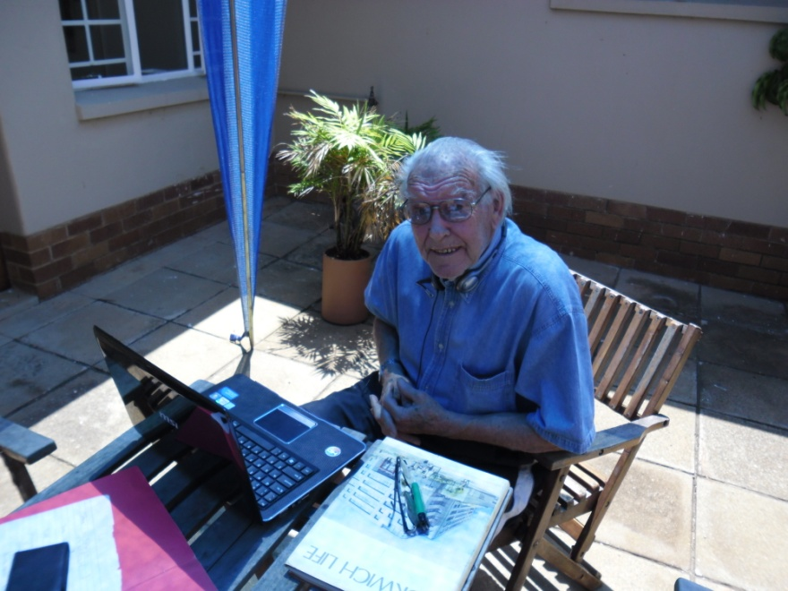
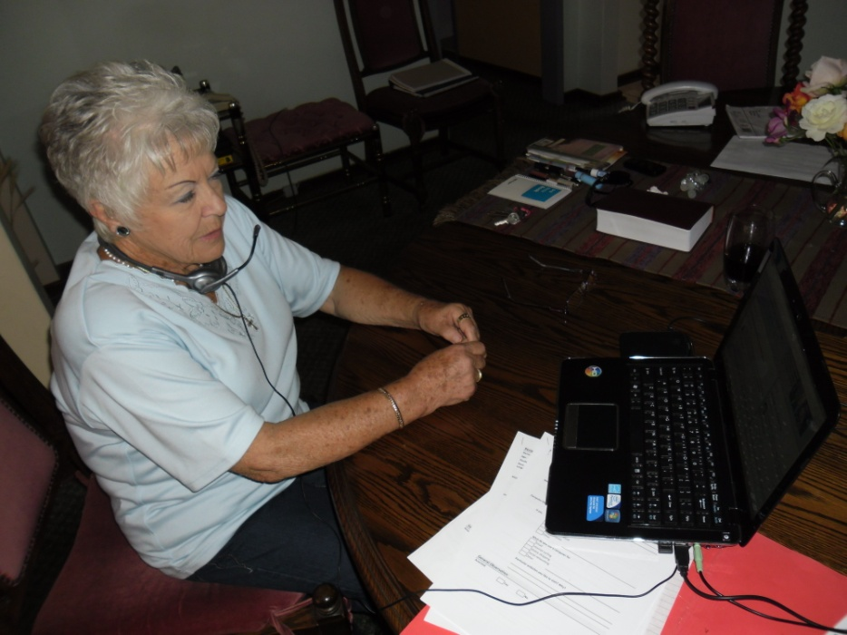
The End

